Slide 1
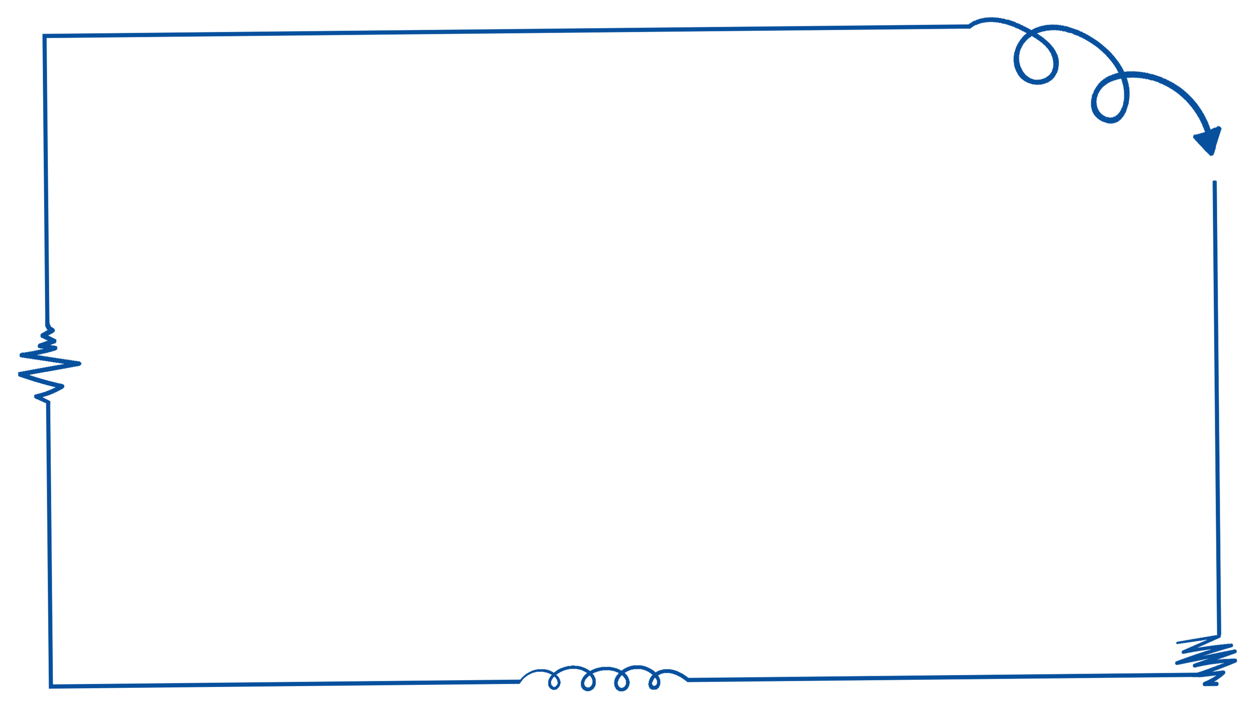

Better Call Us
Ibrahim Elsayed
Toqa Mahmoud
Semon Joseph
Mohamed Alahmady
Radwa Mahmoud
Ola Raafat

Slide 2
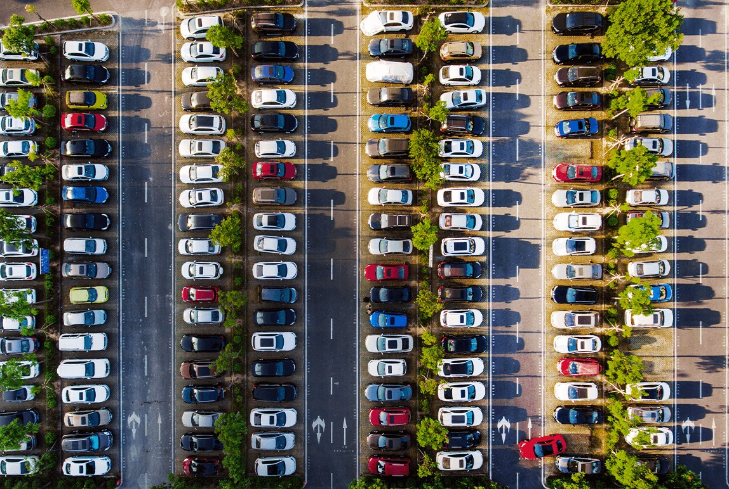
The Problem

Slide 3
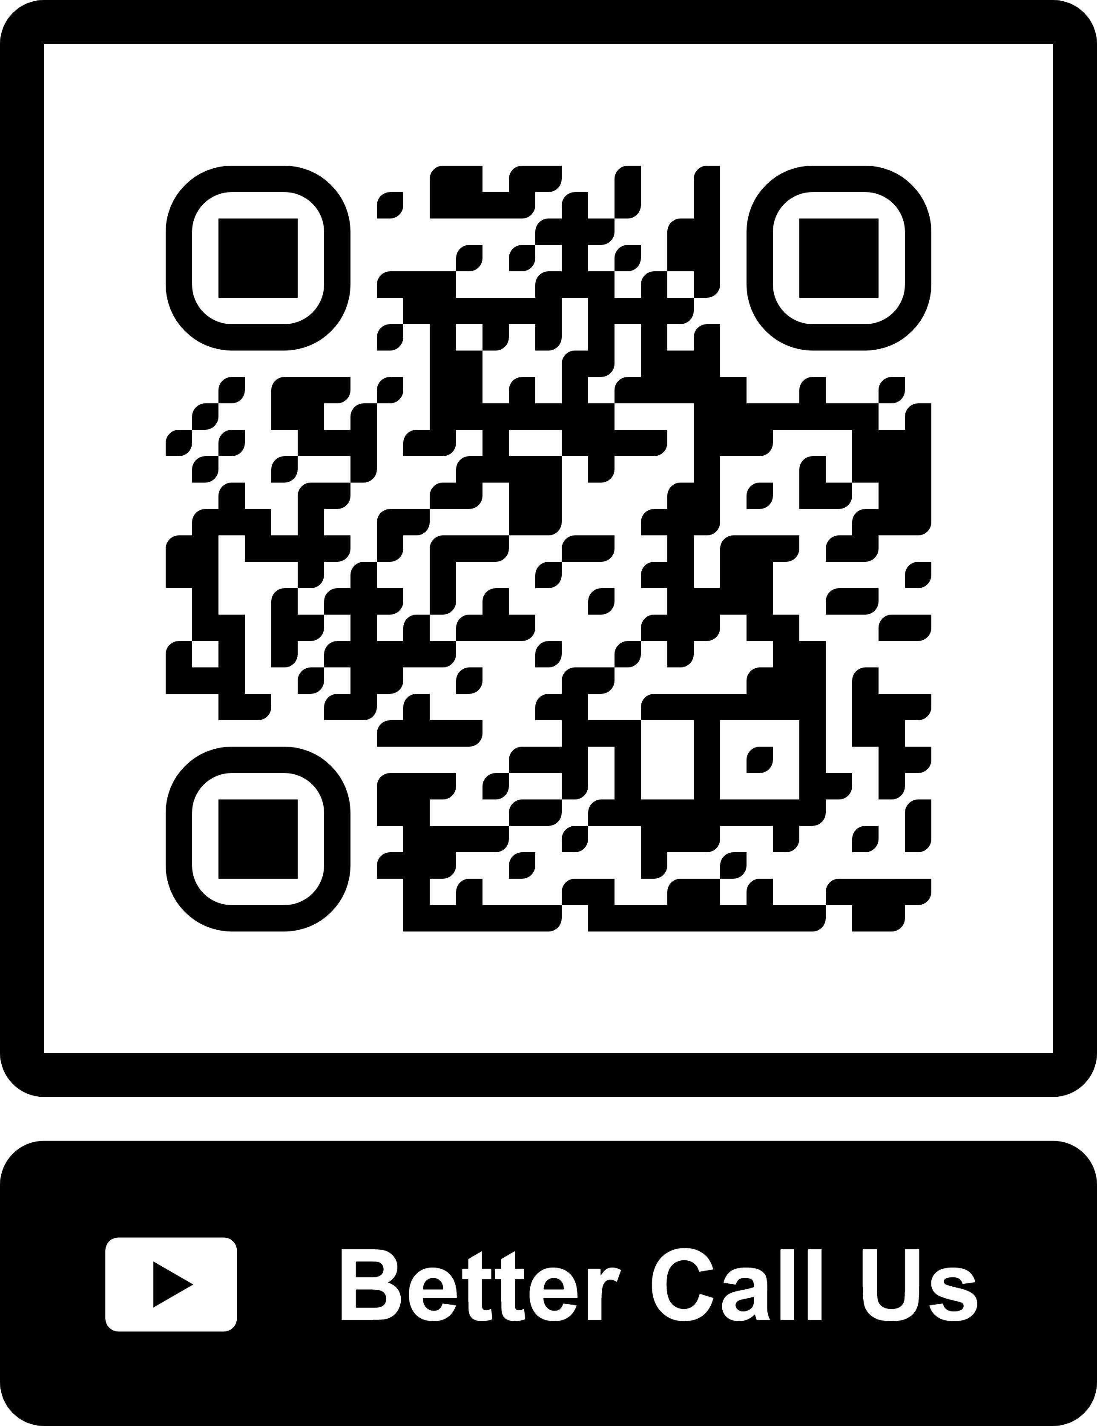
QR

Slide 4
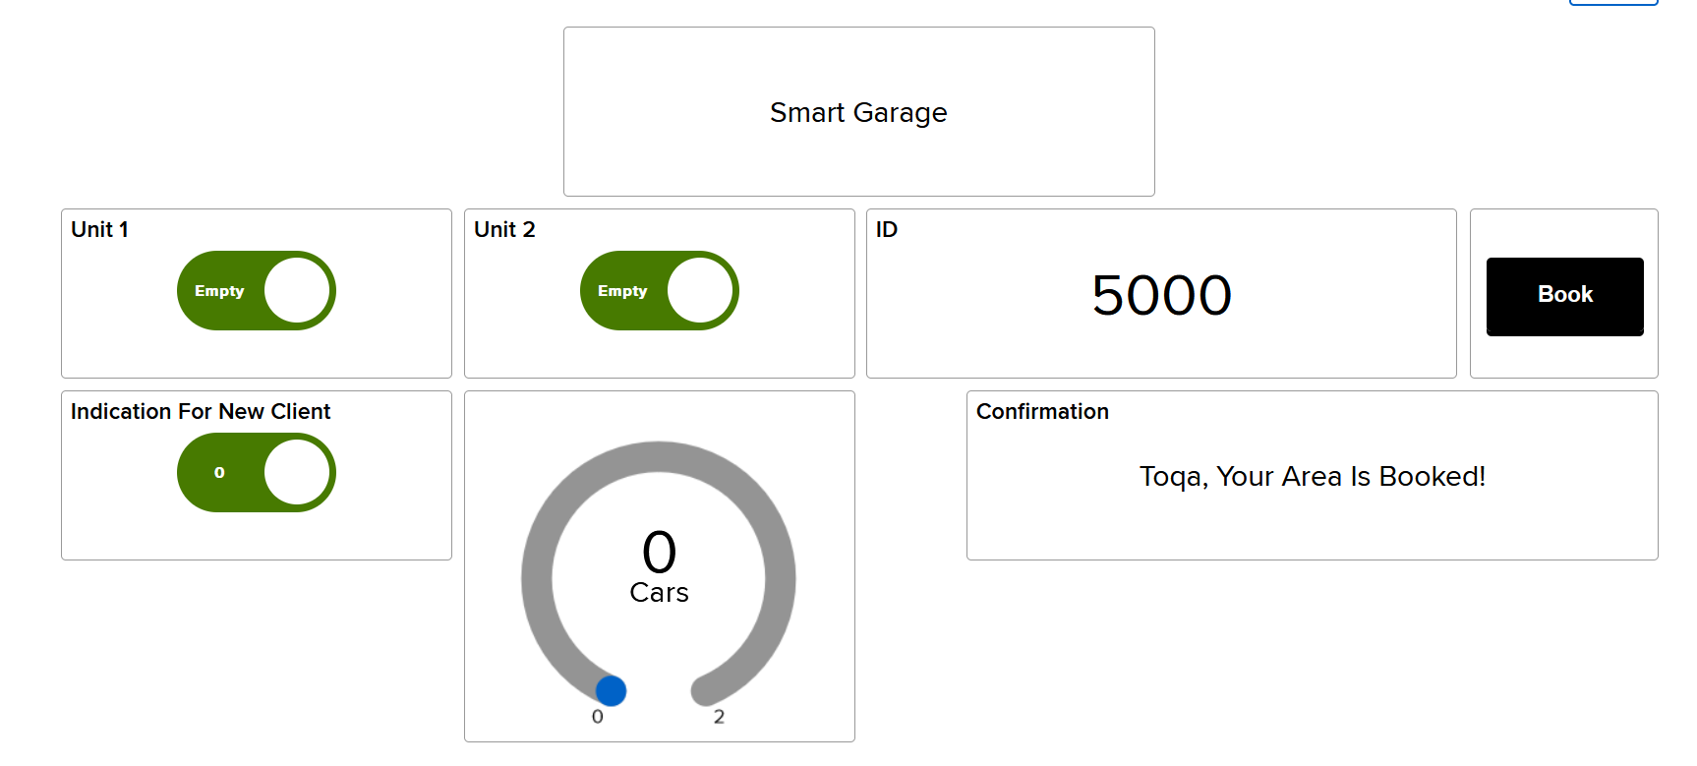
Dashboard

Slide 5
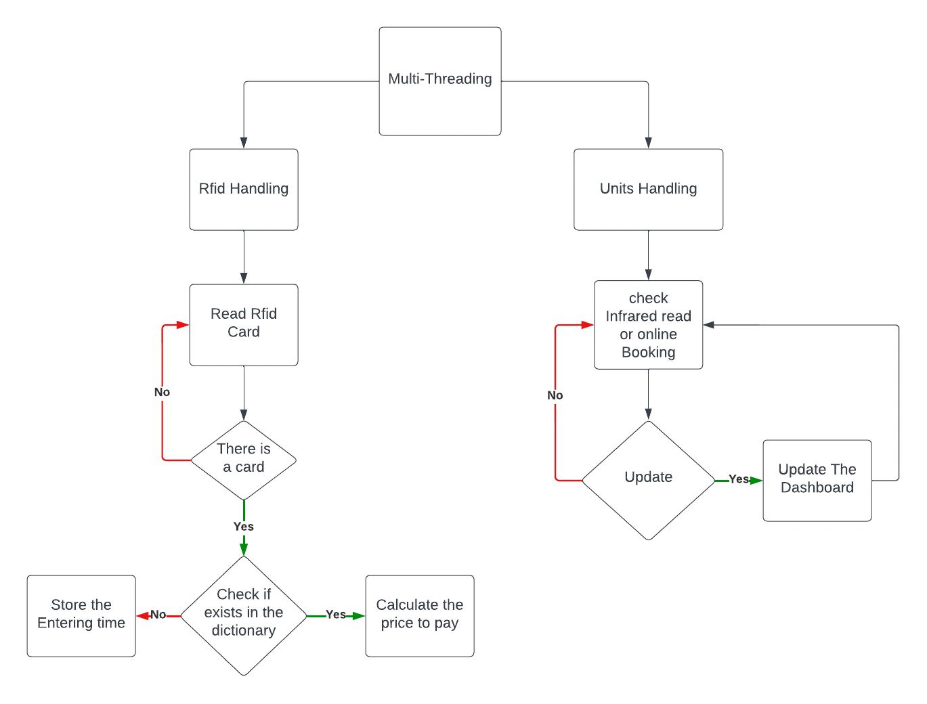
Flowchart

Slide 6
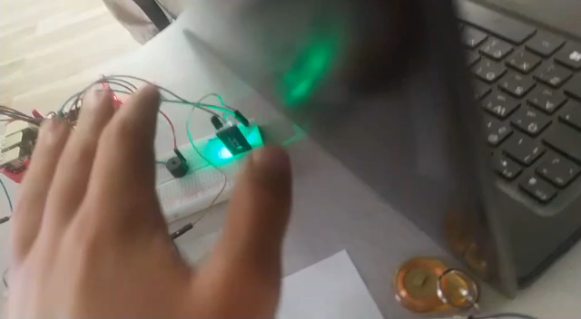
Video

Slide 7
System Ability To Evolve
Website Services
Booking
Normal Package
Premium
Payment
Offline Services
Your Unit
6-Months Package
1-Year Package

Slide 8
Teamwork
Ibrahim Elsayed (Hardware & Software Development)
Toqa Mahmoud (Hardware & Software Development)
Semon Joseph (Design Process & IOT Development)
Mohamed Alahmady (Design Process & IOT Development)
Radwa Mahmoud (Design Process & Software Development)
Ola Raafat (Design Process & Software Development)

